Slide 1
Finding a Formula
Originally written by Mrs. Stretch Updated by Mrs. McLeod

Slide 2
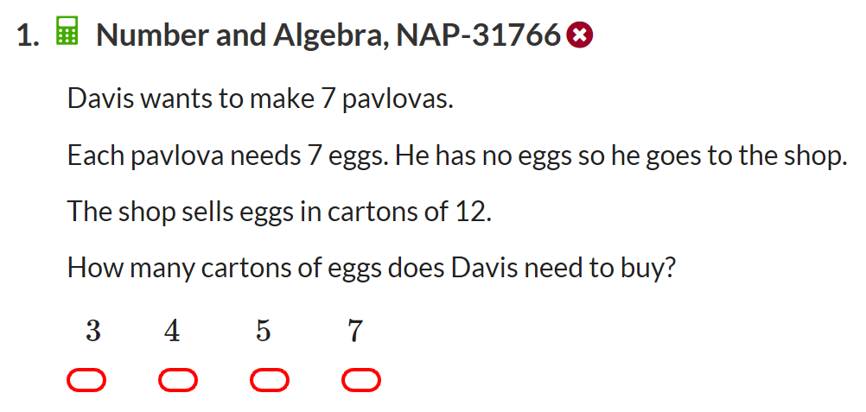
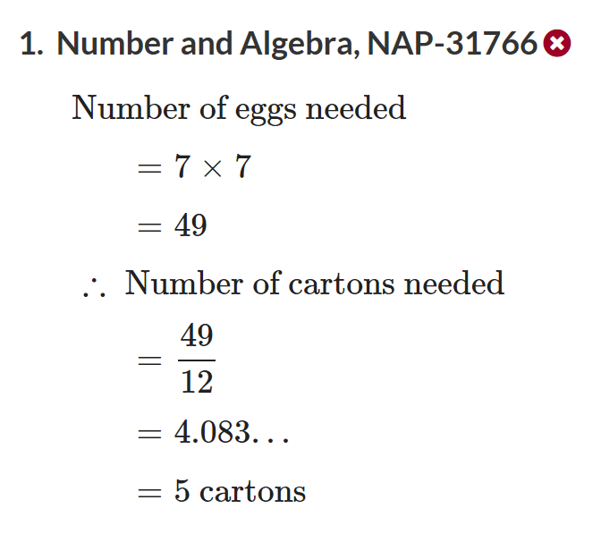

Slide 3
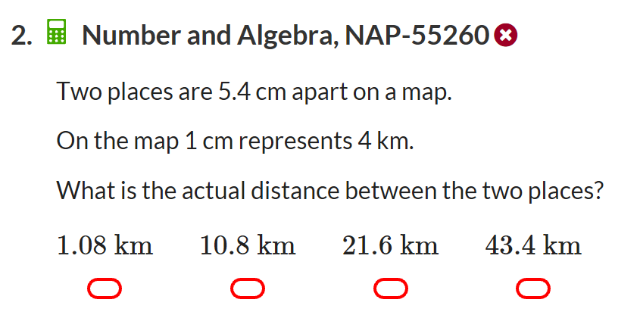
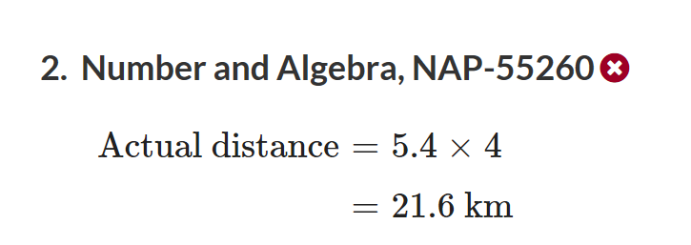

Slide 4
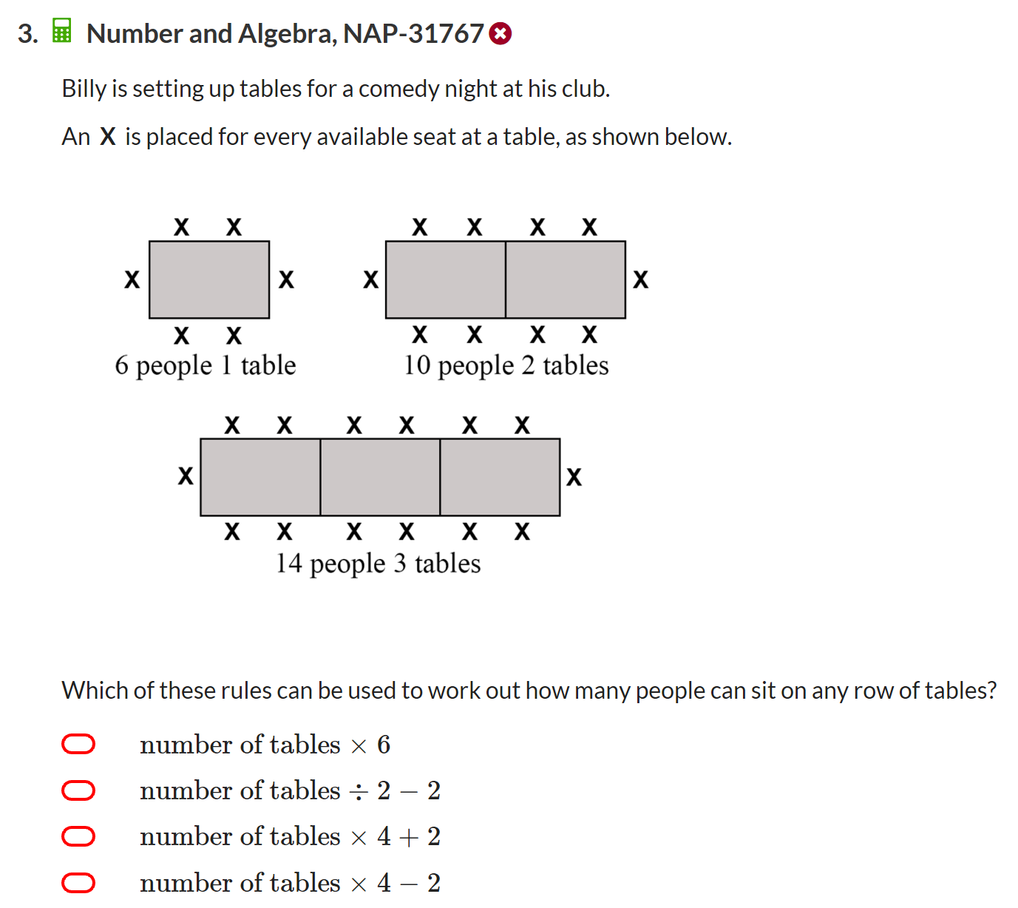
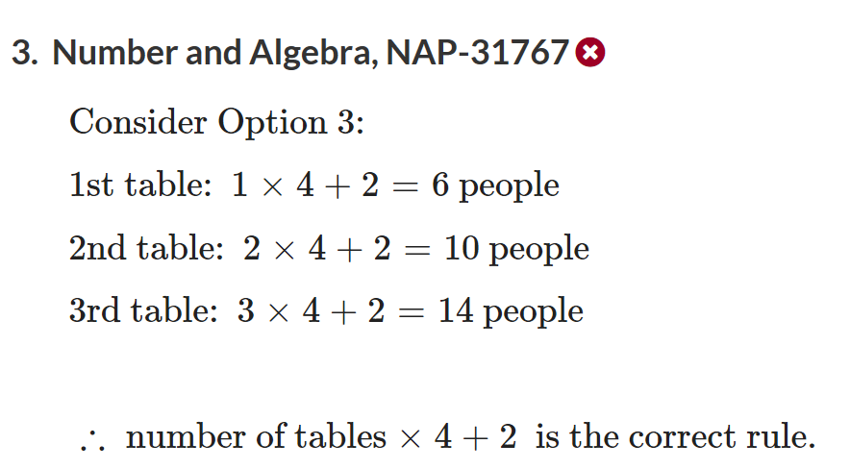

Slide 5
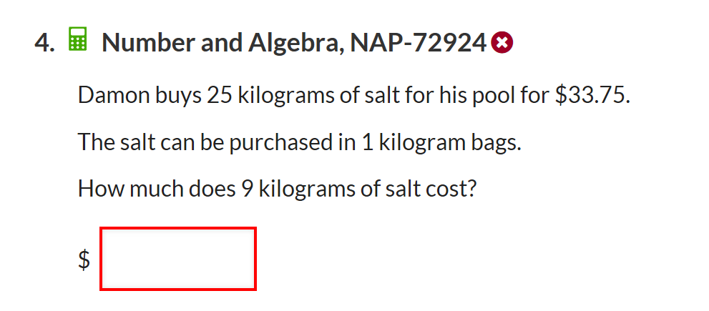
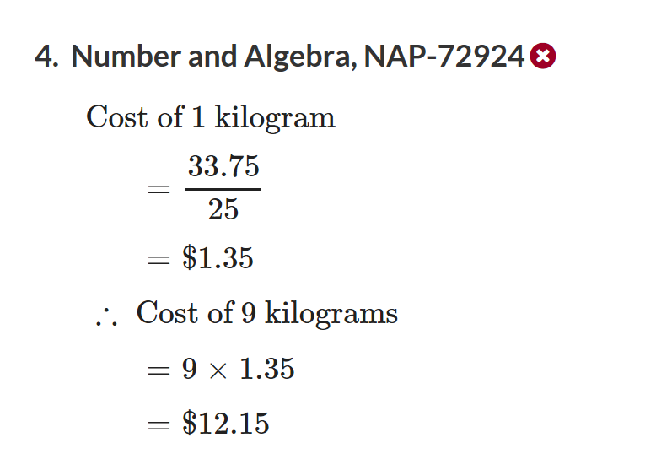

Slide 6
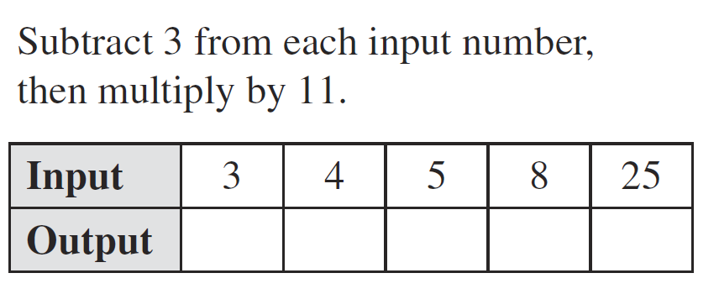
From Last Lesson

Slide 8


Slide 9


Box demonstration
How many blocks are there in the box?
    We don’t know……..
Lets label the mystery number of blocks in the box …… m
    m = number of blocks in the box
m
Notes:
Guide students through the question.
Option 2: Dot plots handout (Scaffolded for kids who may need extra help)

Slide 11
Box demonstration
Lets say we add 2 more blocks into the box
How would a mathematician write that down?
    m + 2 is the number of blocks in the box
m + 2 is the expression
m
Notes:
Guide students through the question.
Option 2: Dot plots handout (Scaffolded for kids who may need extra help)

Slide 13
Box demonstration
Lets go back to just m number of blocks
What happens if I take 6 blocks out of the box?
How would a mathematician write that down?
    m – 6 is the number of blocks in the box
m – 6 is the expression
m
Notes:
Guide students through the question.
Option 2: Dot plots handout (Scaffolded for kids who may need extra help)

Slide 15
Box demonstration
What happens if I get another box with the exact same amount of blocks
How many blocks do I have then?
How would a mathematician write that down?
    m + m = number of blocks in the boxes
How else can a mathematician write it down?
    2 x m = number of blocks in the boxes
    Or
    2m = number of blocks in the boxes
m
These are LIKE TERMS
m
Notes:
Guide students through the question.
Option 2: Dot plots handout (Scaffolded for kids who may need extra help)

Slide 16
Box demonstration
Lets go back to just m number of blocks
I add 3 blocks to the box.
How would a mathematician write that down?
    m + 3
What if I told you there is a total of 10 blocks in the box.
How would a mathematician write that down?
    m + 3 = 10
m
Notes:
Guide students through the question.
Option 2: Dot plots handout (Scaffolded for kids who may need extra help)

Slide 17
Box demonstration
    m + 3 = 10
m + 3 and 10 are the expressions
m + 3 = 10 is the equation
How would we work out what m is?
m
Notes:
Guide students through the question.
Option 2: Dot plots handout (Scaffolded for kids who may need extra help)

Slide 18

Your equation has to be balanced on each side
So m is = 7
m + 3
7 + 3
10

Slide 19
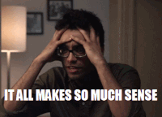
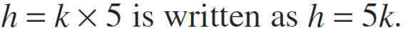
24
7
30
Algebra: Finding a Formula
Date
EQ – How do you find a formula?
What is Algebra?
What is a Formula?
Algebra can be used to write a rule in a simple way
We can use a letter or symbol in place of a number
When a rule is written using a letter or symbol, its called a formula
A letter or symbol in a formula is called a variable because its value can change
When multiplying numbers and variables, we do not need to show the multiplication sign.

Slide 20
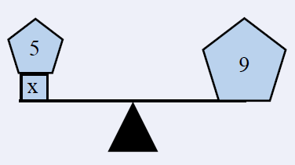
24
7
30
Word Equations
Date:
EQ – How do we correctly write mathematical equations?
How to write an equation?
1 . What is the worded equation?
When a number is added to five the answer is 9
2. How would a mathematician write that down?
number = x x + 5 = 9
3. The two expressions has to be
balanced so what does x equal?
x = 4
4 + 5 = 9

Slide 21
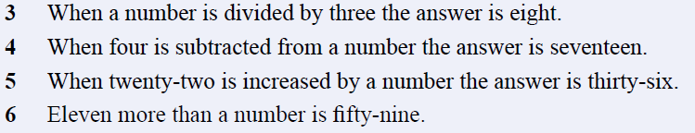

Complete the following:
Don’t forget your summery!!
Task

Slide 22
Practice

Slide 23
Task
Complete the following:
Don’t forget your summery!!

Slide 24
Glossary Words
Expression
Equation
Variable
Formula
Like terms
Do you have definitions down for each of these?

